Slide 1
Atlanta Bike Share
Project Pitch – GA Data Science

Slide 2


Slide 3
Problem Statement
What is the likelihood that a Bike Share program will succeed in the City of Atlanta? http://atlantabicycleshare.com/

Slide 4
My Objective
Determine the success criteria that will allow for successful adoption of a Bike Share program in Atlanta by exploring Bike Share data from NYC, D.C. , San Francisco and possibly Boston.
Questions I have:
How many Men vs. Women have used Bike Share?
Which age range is the largest subscribers ?
Frequency of distance Bikes have been used by whom?
Popular locations for Bike Share in each relevant city?

Slide 5
Data that shall be used
Data from Citi Bike, Capital Bike Share, Bay Area Bike Share, and Divvy Data
Other Sources include Atlanta Government Open Data for Atlanta metrics
https://www.citibikenyc.com/system-data
http://govathon.com/data.html
http://arc.garc.opendata.arcgis.com/datasets/5c40e76746374d71acaa0a7b3973b195_120?uiTab=table
http://www.bayareabikeshare.com/open-data
http://www.civicdata.com/dataset/nyc-bike-share-trip-data
https://www.capitalbikeshare.com/trip-history-data
https://www.divvybikes.com/data
https://www.divvybikes.com/datachallenge

Slide 6
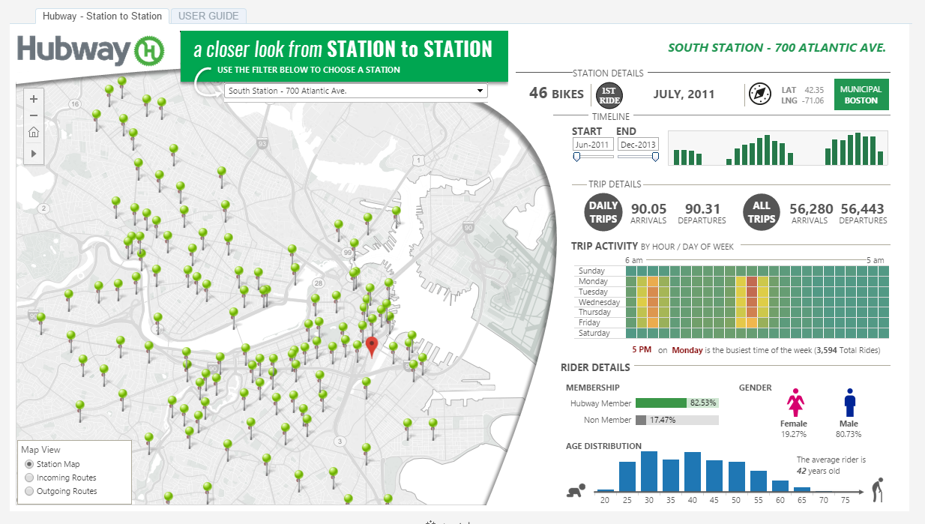

Slide 7
Why did I choose this topic
Interest in alternative transportation means in Atlanta. As a former resident of NYC, I am interested to know if successful NYC public initiatives will work out in Atlanta.

